Slide 1
Algorithms and Data Structures for Efficient Free Space Reclamation in WAFL
This paper is included in the Proceedings of
the 15th USENIX Conference on
File and Storage Technologies (FAST ’17).
February 27–March 2, 2017 • Santa Clara, CA, USA
Ijaz Ali
2017/05/01

Slide 2
Write Anywhere File Layout(WAFL)
WAFL was originally designed 1994
Max file size 28 GIB→400 TiB
In 2000 WAFL used two mechanisms in tandem prefetching
To avoid the cyclic dependcy problem
2010 WAFL supported file systems that were 100TiB in size

Slide 3
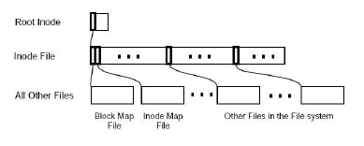
Meta Data Files
WAFL store meta-data in files
There are three meta-data in files
1) I- nodes file ,contains the I- nodes for the file system
2) Block-map file, identifies free blocks
3) I- node –map file, identifies free i-nodes
The term map is used instead of bit map because these files use more than one bit for each entry

Slide 4
Why use file to hold meta-data ?
Allows writing meta-data blocks any where on disk
Write- anywhere allows operating efficiently with RAID
1) WAFL works with RAID-4
2) Scheduling multiple Writes to the same RAID stipe whenever possible
3) Avoid the 4-to 1 short-write penalty
Make it easy to increase the size of the file system on the fly

Slide 5
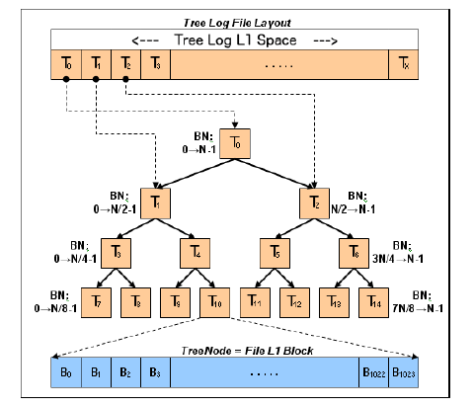
Tree Log
WAFL was the tree log (or TLog)
TLog from the nodes of a binary tree
A delete-logged block is inserted into the root node
If root node fills up its contents are pushed to the children nodes based on the range they cover.
Example :
n blocks and each activemap block covers 32K leaf nodes
Tlog size to approximately 1.5%

Slide 6
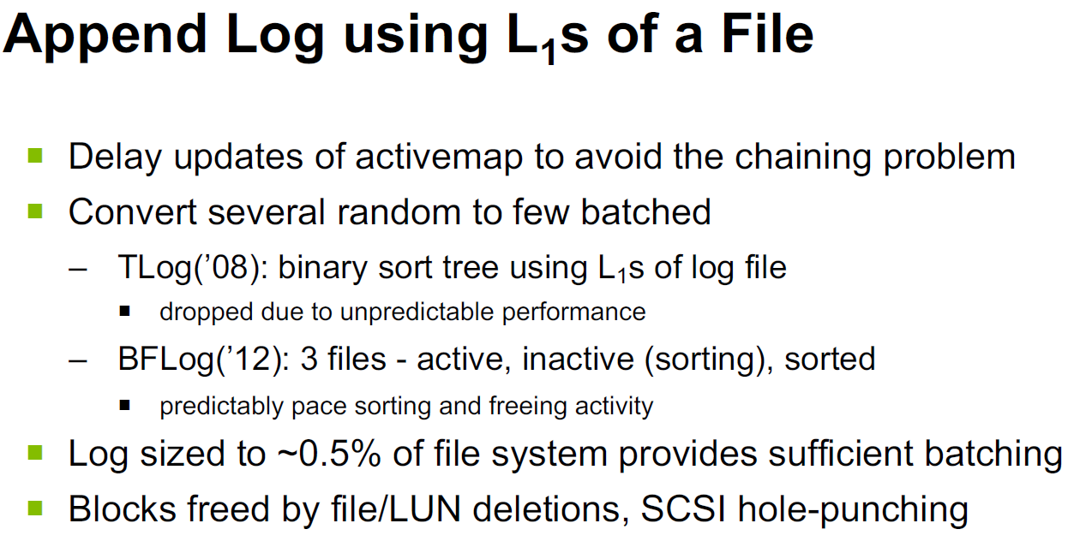

Slide 7
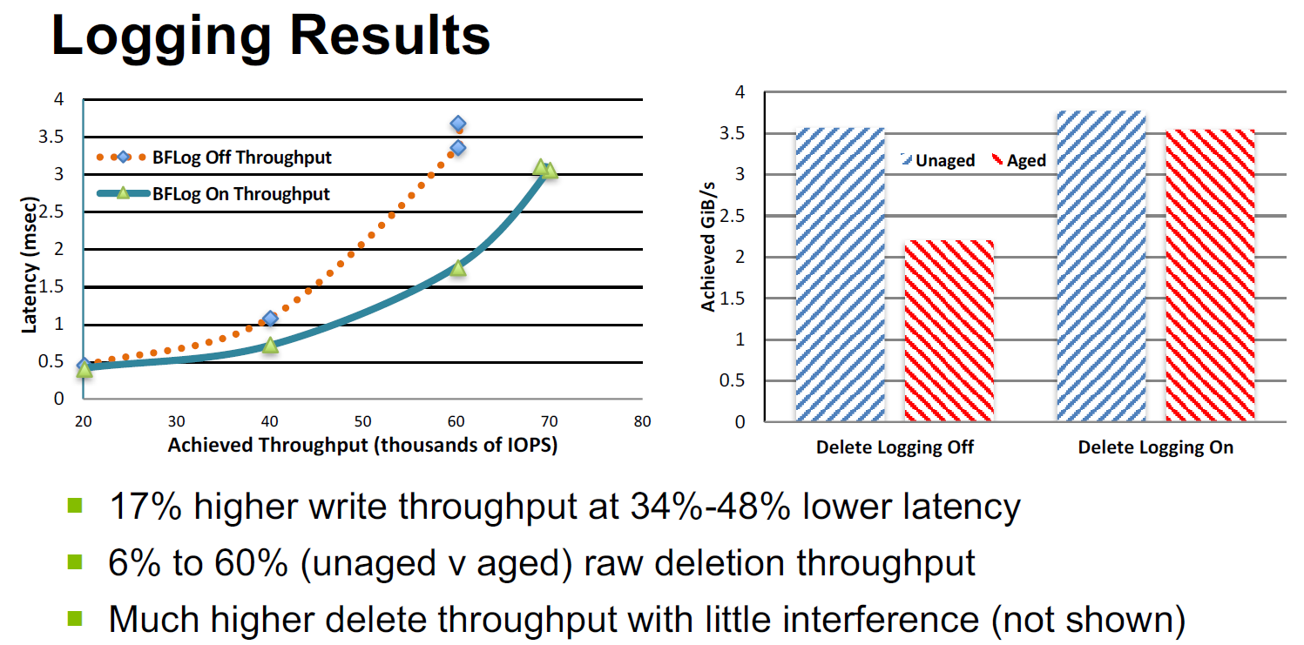

Slide 8
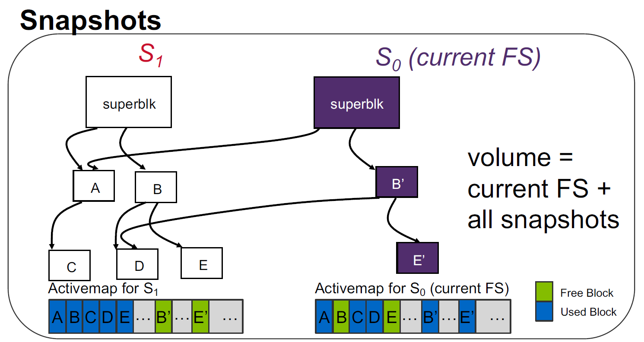
Snapshot :Read-only copy of the entire file system
Users can access snapshots through to NFS to recover files that they have accidently changed or removed
System administrators can used snapshots to create backups safely from a running system
WAFL uses snapshots internally so that it can recover quickly from crashes

Slide 9
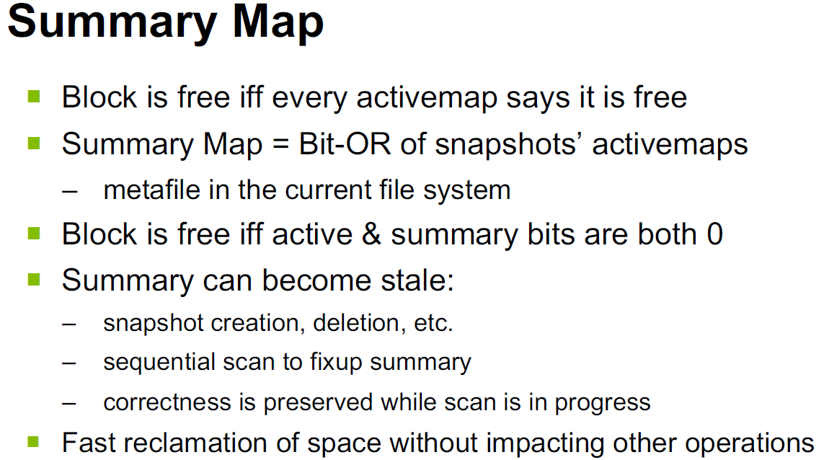

Slide 10
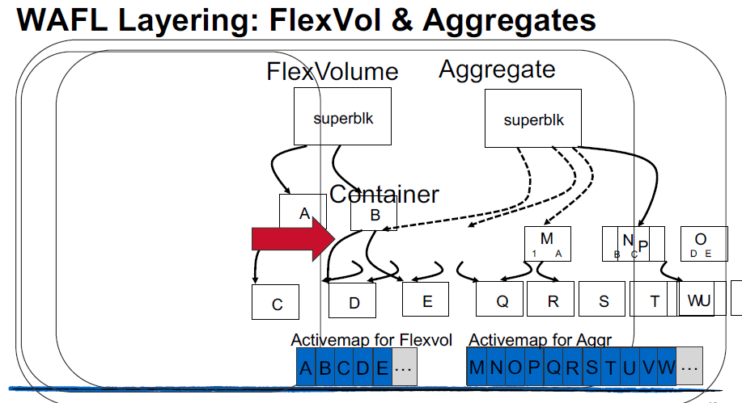

Slide 11
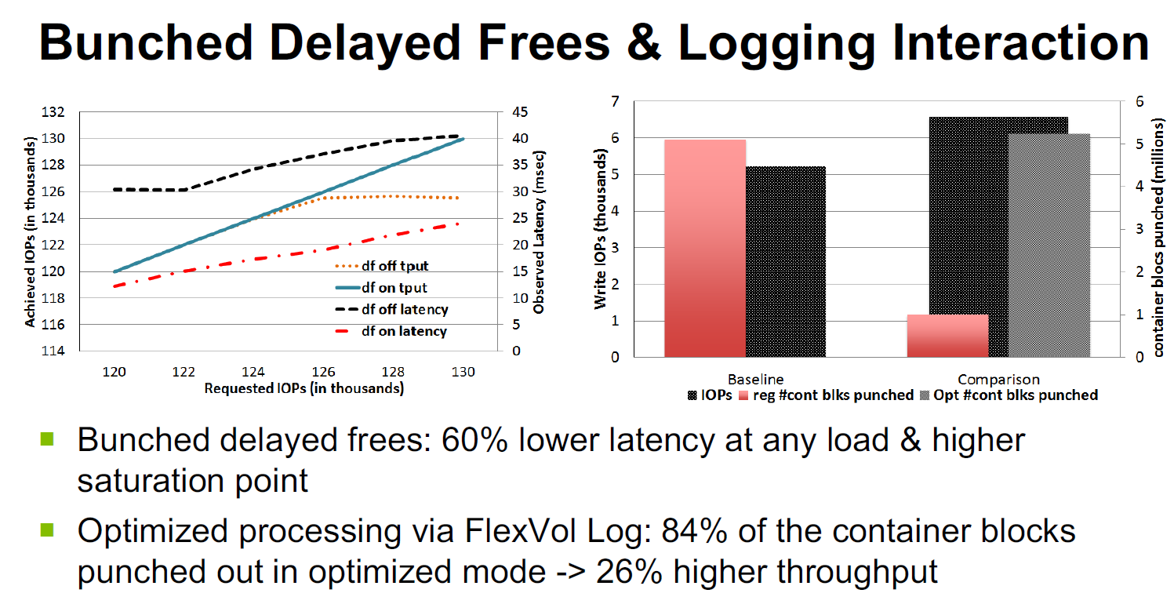

Slide 12
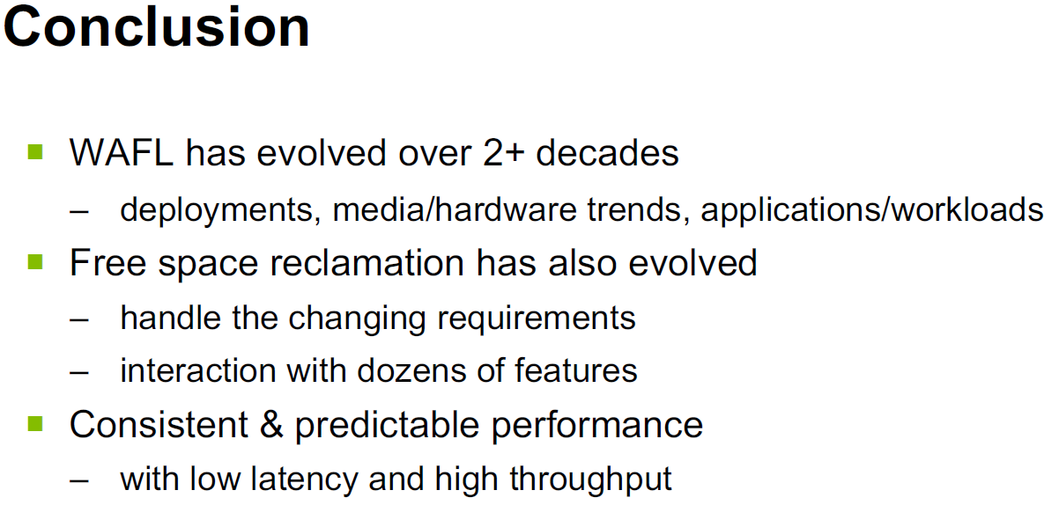

Slide 13


